Slide 1


Exploring the World of Movies: A Flutter Project on Movie Catalogue

Slide 2




Introduction
Welcome to the world of movies! In this Flutter project, we will the fascinating realm of cinematic storytelling. Get ready to dive into a
of diverse films, from timeless classics to modern blockbusters.

Slide 3


Movie Database
Discover a vast collection of movie data, including titles, , and . With the Flutter framework, we can create an intuitive
interface to extensive movie
and search through this
.

Slide 4
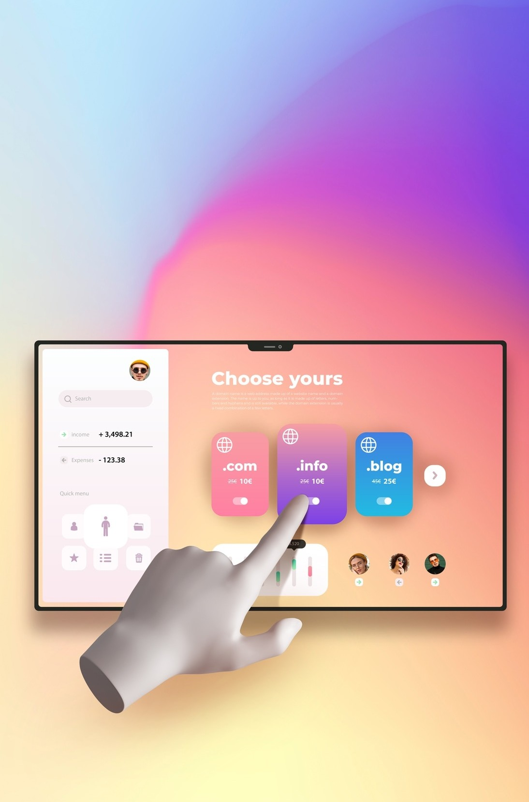

User Interface
Design a captivating user interface with
to showcase movie details, including synopsis,
, and . Utilize Flutter's widgets to create an engaging and visually appealing .

Slide 5






Movie Details
Delve into the specifics of each movie, from plot summaries to and . With Flutter, we can present these details in an organized and visually appealing manner, enhancing the user's .

Slide 6
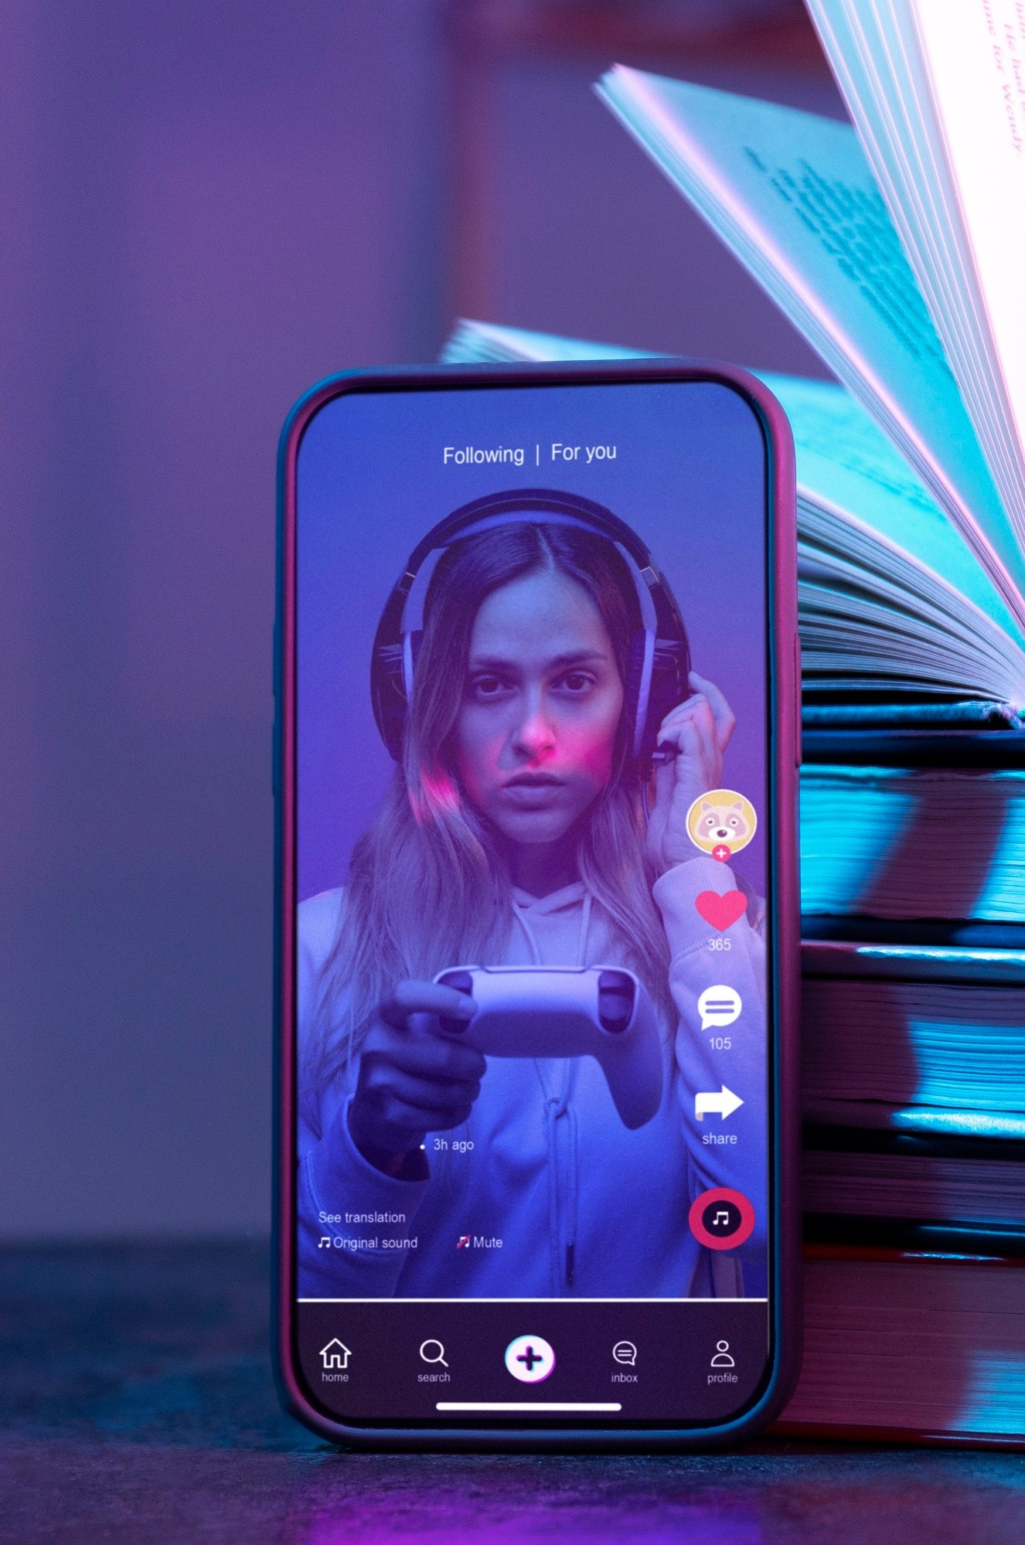

Interactive Features
Implement interactive features such as user reviews, , and
algorithms. With Flutter's capabilities, we can create a dynamic and engaging movie experience.

Slide 7



Conclusion
In conclusion, this Flutter project has provided a comprehensive exploration of the movie world, demonstrating the potential of Flutter in creating immersive and interactive movie catalogues. Let's continue to the art of cinema through innovative development.

Slide 8


Thanks!

